Slide 1



Slide 2

SCHEDULE
Presentations
Why Arduino? - 5 min
The hardware - 5 min
Sending Code - 5 min
Code review - 5 min
Challenges
Blink faster - 5 min
Add an LED - 5 min
Using the breadboard - 5 min
Adding leds - 5 min
Train light - 10 min
Stop Light - 10 min

Slide 3

WHY?

Slide 4


Slide 5
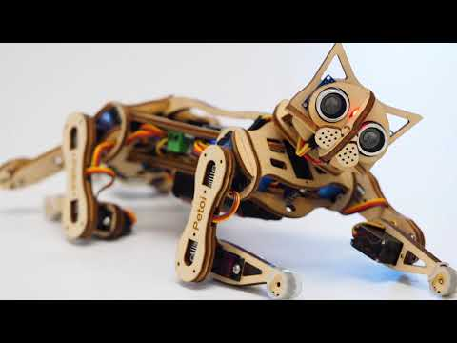

Slide 6


Slide 7
